Slide 1
A2 Chemistry
Solutions

Slide 2
Objectives
solutions can be classified as saturated, unsaturated or supersaturated;
the solubility of substances in water, including ionic and polar and non-polar molecular substances, can be explained by the intermolecular forces, including ion-dipole interactions between species in the substances and water molecules, and is affected by changes in temperature

Slide 3
Success criteria
Define solute, solvent and solution
Classify substances as saturated, unsaturated or supersaturated
Explain ‘like vs like’ solubility

Slide 4
Key words
homogeneous
solute
solvent
solution
saturated
supersaturated
solubility

Slide 5
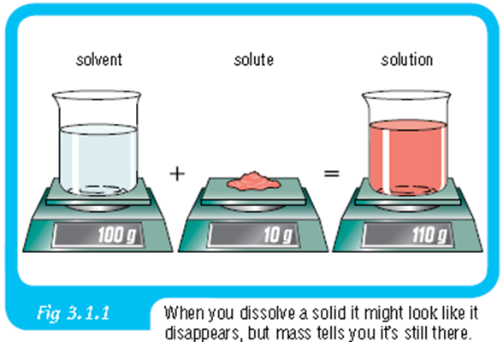
Solutions
A solution is a homogeneous mixture, formed when one substance, the solute, dissolves in another, the solvent.

Slide 6
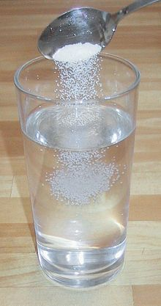
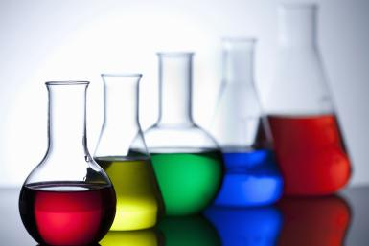
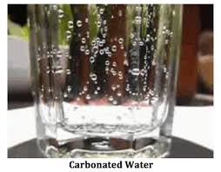

Solvents are usually liquids, while solutes may be solids, liquids or gases

Slide 7
Types of solutions
Unsaturated: any extra solute dissolves
Saturated: No more solute will dissolve (any extra added would sink to the bottom) at that temperature
Supersaturated: Heated to allow more solute to dissolve (if cooled, solute will come out of solution)

Slide 8
Solubility
The amount of solute that will dissolve in a quantity of solvent at a particular temperature
Solubility is affected by polarity of the solute and solvent

Slide 9

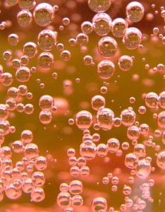
Solubility and temperature
The solubility of solid and liquid solutes increases with increasing temperature
The solubility of gas solutes decreases with increasing temperature

Slide 10
Success criteria
Define solute, solvent and solution
Classify substances as saturated, unsaturated or supersaturated
Explain ‘like vs like’ solubility

